Slide 1
Cloud Computing
Module 8
Distributed File System
And
Hadoop

Slide 2
Agenda
Files and File System
Distributed File System
HDFS (Hadoop Distributed File System)
MapReduce
MapReduce Problems

Slide 3
Terminology
Service: It is a software entity running on one or more machines and providing a particular type of function to a priori unknown clients.
Server: A server is the service software running on a single machine.
Client: A client is a process that can invoke a service using a set of operations
that form its client interface. Sometimes, a lower level interface is defined for the
actual cross-machine interaction. Clients implement interfaces suitable for higher
level applications or direct access by humans.

Slide 4
File System of a UniProcessor System
File: A file is a collection of data stored in one unit, identified by a filename.
A file system is a subsystem of the operating system that performs file
management activities such as organization, storing, retrieval, naming, sharing,
and protection of files.
A file system provides file services (Creating a file, reading from a file, writing to a file, etc) to clients.
The purpose of file system is to provide long-term storage. It does so by implementing files- named objects that exist from their explicit creation until their explicit destruction and are immune to temporary failures in the system.

Slide 5
File System of a UniProcessor System (Cont…)
The primary hardware component a file server controls is a set of secondary
storage devices (i.e., magnetic disks) on which files are stored and from which they
are retrieved according to the client’s requests.
We often say that a server, or a machine, stores a file, meaning the file resides on
one of its attached devices.
We refer to the file system offered by a uniprocessor, time-sharing operating system as a conventional file system.
A file system frees the programmer from concerns about the details of space
allocation and layout of the secondary storage device.

Slide 6
File Types

Slide 7
Distributed System and Its File System
Def (Distributed System): It is a collection of loosely connected machines either a
mainframe or a workstation interconnected by a communication network.
Def(Distributed File System): A DFS is a file system, whose clients, servers, and
storage devices are dispersed among the machines of a distributed system.
service activity has to be carried out across the network,
instead of a single centralized data repository there are multiple and independent storage devices.
Note: The configuration and implementation of a DFS may vary.
Note2: There are configurations where servers run on dedicated machines, as well as configurations where a machine can be both a server and a client.

Slide 8
Features of Distributed File System
Transparency:
Network transparency: Clients should be able to access remote files using the same set of file operations applicable to local files.
Note: That is, the client interface of a DFS should not distinguish between local and remote files. It is up to the DFS to locate the files and arrange for the trans- port of the data.
Mobility: It implies that users can log in to any machine in the system; that is, they are not forced to use a specific machine. A transparent DFS facilitates user mobility by bringing the user’s environ-ment (e.g., home directory) to wherever he or she logs in.
Naming transparency:
The name of the file should give no hint as to the location of the file. The name of the file must not be changed when moving from one node to another.
Replication transparency: If a file is replicated on multiple nodes, both the existence of multiple copies and their locations should be hidden from the clients.

Slide 9
Features of Distributed File System (Cont…)
2. Performance:
It is the amount of time needed to satisfy service requests.
In conventional systems, this time consists of disk access time and a small amount of CPU processing time. In a DFS, a remote
access has the additional overhead attributed to the distributed
structure. This overhead includes the time needed to deliver the
request to a server, as well as the time needed to get the response across the network back to the client.

Slide 10
Features of Distributed File System (Cont…)
3. Fault tolerance: Communication faults, machine failures (of type fail stop), storage device crashes, and decays of storage media are all considered to be faults that should be tolerated to some extent.
A fault-tolerant system should continue functioning, perhaps in a degraded form, in the face of
these failures.
The degradation can be in performance, functionality, or both but should be proportional, in some sense, to the failures causing it.
4. Scalability: The capability of a system to adapt to increased service load is called scalability.
Systems have bounded resources and can become completely saturated under increased load.
Regarding a file system, saturation occurs, for example, when a server’s CPU runs at very high
utilization rate or when disks are almost full.
In DFS, a scalable system should react more gracefully to increased load.
In short, a scalable design should withstand high-service load, accommodate growth of the user community, and enable simple integration of added resources.
Note: Fault tolerance and scalability are mutually related to each other.

Slide 11
Features of Distributed File System (Cont…)
5. Simplicity and ease of use: User interface to the file system be simple and number of commands should be as small as possible.
6. High reliability: Probability of loss of stored data should be minimized. System should automatically generate backup copies of critical files.
7. Data integrity: Concurrent access requests from multiple users who are competing to access
the file must be properly synchronized by the use of some form of concurrency control mechanism. Atomic transactions can also be provided.
8. Security: Users should be confident of the privacy of their data.
9. Heterogeneity: There should be easy access to shared data on diverse platforms.

Slide 12
Centralized Computing Versus Distributed Computing

Slide 13
Distributed System or Computing
Def: A distributed system is a collection of independent components located on different machines that
share messages with each other in order to achieve common goals.
Examples of Distributed Systems are ATMs(Bank Machines), Internet, etc.

Slide 14
Why Distributed Computing?
Nature of Application
Performance
Computing Intensive: The task could consume a lot of time in
consuming
Data Intensive: The task that deals with large size of datasets.
Robustness:
-No Single Point of Failure
- Othernodes can execute the same task executed on the
failed node.

Slide 15
Advantages and Disadvantages of Distributed Computing
Major benefits include:
Unlimited Horizontal Scaling - machines can be added whenever required.
Low Latency - having machines that are geographically located closer to users, it will reduce the time it takes to serve users.
Fault Tolerance - if one server or data centre goes down, others could still serve the users of the service.
Disadvantages:
Data Integration & Consistency
Network and Communication Failure
Management Overhead

Slide 16
Computers in a Distributed Computing
Workstations: Computers used by end users to
perform computing.
Servers: Computers which provide resources and services
Personal Assistance Devices: Handheld devices connected to the system via a wireless network.

Slide 17
Implementation of DFS
A DFS can be implemented as part of a distributed operating system or, alternatively, by a software layer whose task is to manage the communication between conventional operating systems and file systems.
Note: The distinctive features of a DFS are the multiplicity and autonomy of clients and servers in the system.

Slide 18
How do we implement DFS?
Any DFS must look into the following:
User Interface
Naming
Inter process Communication
File access mechanism
File consistency
Synchronization
Locking
Atomic transactions
Error recovery
Examples of DFS are Google File System, HDFS(Hadoop Distributed File System)
Reference:https://scholarworks.rit.edu/cgi/viewcontent.cgi?article=1322&context=theses

Slide 19
Big Data
What is Big Data?
Big Data is a collection of data that is huge in volume, yet growing
exponentially with time.
It is a data with so large size and complexity that none of traditional
data management tools can store it or process it efficiently.
Few examples of Big Data?.
Stock Market Exchange Data, Social Media, etc.

Slide 20
Challenges of Big Data
Storage
Computational Efficiency
Data Loss
Cost

Slide 21
Characteristics Of Big Data
Volume – It refers to the size of the data that is enormous. Size of data plays a very crucial role in determining value out of data.
Variety-: It refers to heterogeneous sources and the nature of data, both structured and unstructured. Data in the form of spreadsheets, tables (RDBMS), emails, photos, videos, monitoring devices, PDFs, audio, etc.
Velocity : It refers to the speed of generation of data. How fast the data is generated and processed to meet the demands, determines real potential in the data. The data flows in from sources like business processes, application logs, networks, and social media sites, sensors, Mobile devices, etc. The flow of data is massive and continuous.
Variability – This refers to the inconsistency which can be shown by the data at times, thus hampering the process of being able to handle and manage the data effectively.

Slide 22
Types Of Big Data
Structured Data: Any data that can be stored, accessed and processed in the form of fixed format is termed as a 'structured' data. For example, data stored in tables.
Unstructured Data: Any data with unknown form or the structure is classified as unstructured data. For example, heterogeneous data source containing a combination of simple text files, images, videos etc.
Semi-structured Data: It can can contain both the forms (structured and unstructured) of data. For example, the data represented in XML files.
Benefits of Processing Big Data:
Businesses can utilize outside intelligence while taking decisions.
Early identification of risk to the product/services, if any.
Better operational efficiency.

Slide 23
Hadoop
Hadoop is an open source software framework used to develop data processing applications which are executed in a distributed
computing environment.
It offers the cost effective solution to the Big Data Problem.
It is designed and deployed by Apache Foundation.
It is one of the best cloud Platforms for Big Data.
Applications built using HADOOP are run on large data sets
distributed across clusters of commodity computers

Slide 24
Hadoop (Cont…)
Hadoop includes a Distributed File System (HDFS) and a MapReduce
framework to transform and analyze huge data sets.
An important characteristic of Hadoop is the partitioning of data and
computation across many (thousands) of hosts, and executing application
computations in parallel close to their data.
A Hadoop cluster scales computation capacity, storage capacity and IO
bandwidth by simply adding commodity servers.

Slide 25
Hadoop Features
Suitable for Big Data Analysis
Scalability
Fault Tolerance
High Availability
Cost-Effective
High Flexibility
Faster Data Processing

Slide 26
Hadoop Terminology
Job: a full program – an execution of a Mapper and Reducer across data set
Task: An execution of a mapper or reducer on a slice of data.
Task Attempt: A particular instance of an attempt to execute a task on a machine

Slide 27
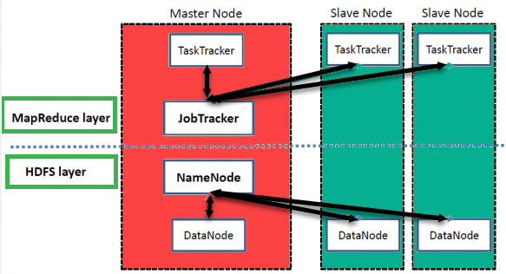
Hadoop Architecture
Hadoop Master-Slave Architecture for data storage and distributed data processing using HDFS and MapReduce

Slide 28
1. HDFS (Hadoop Distributed File System)
Hadoop File System was developed using distributed file system design.
It allows us to store large data across multiple nodes in a Hadoop cluster. Each file on HDFS is stored as sequence of blocks all of which are of the same size except the last block.
HDFS stores file system metadata and application data separately.
Metadata on a dedicated server, called the NameNode. Application data
are stored on other servers called DataNodes.
All servers are fully connected and communicate with each other using TCP-based
protocols.
In HDFS, the file content is replicated on multiple DataNodes for reliability. This strategy
has the added advantage that data transfer band-width is multiplied, and there are more
opportunities for locating computation near the needed data.
By default a file’s replication factor is three
Ref: https://storageconference.us/2010/Papers/MSST/Shvachko.pdf (HDFS)

Slide 29
2. MapReduce
It is a distributed programming model for processing large datasets of key-value pairs in
parallel on large clusters (thousands of nodes) of commodity hardware in a reliable, fault-tolerant manner..
It is conceived at Google Inc.
MapReduce consists of two distinct tasks – Map and Reduce.
It works by breaking the processing into two phases.: the map phase and the reduce
phase.
Each phase has key-values pairs as input and output, the types of which may be chosen by
the programmer.
As the name MapReduce suggests, the reducer phase takes place after the mapper phase has been completed.
It can be implementing in any programming languages, e.g., Java, Python, etc.
It manages communications, data transfers, parallel execution across distributed servers

Slide 30
Hadoop Architecture (Cont…)
MasterNode/NameNode:
Stores metadata for the files, like the directory structure of a typical FileSystem.
It keeps track of where across the cluster the file data is kept.
The server holding the NameNode instance is quite crucial, as there is only one.
Transaction log for file deletes/adds, etc.
Handles creation of more replica blocks when necessary after a DataNode failure
DataNode/ Slave Node:
Stores the actual data in HDFS and they connect to the NameNode on startup.
They respond to requests from the NameNode for filesystem operations. Client applications can directly talk to the DataNodes
Can run on any underlying filesystem (ext3/4, NTFS, etc)
Notifies NameNode of what blocks it has.
NameNode replicates blocks 2x in local rack, 1x elsewhere

Slide 31
Hadoop Architecture (Cont…)
The Job Tracker:
It is the service (runs on Master node) within Hadoop that distributes MapReduce tasks to specific nodes in the cluster(nodes that have data).
It is responsible for scheduling and monitoring MapReduce jobs
Responds to client request for job submission and status
The Task Tracker:
The TaskTrackers are the workers (nodes).
Workers that accepts Map, Reduce and Shuffles tasks from job tracker, launches them and keeps track of their progress, reports the same to job tracker.
Keeps track of resource usage of tasks and kills the tasks that overshoots their memory limits

Slide 32
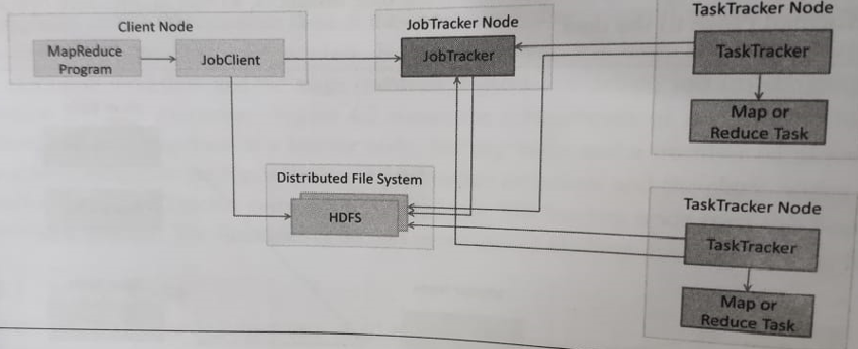
Hadoop MapReduce Job Execution

Slide 33
Data Flow in MapReduce

Slide 34
Inputs and outputs of Both Mappers and Reducers
Mapper, where a block of data is read and processed to produce key-value pairs as intermediate outputs.
Note: The input of the mapper is also key-value pair.
ii) The Reducer receives the key-value pair from multiple map jobs. Then, the reducer aggregates those intermediate data tuples (intermediate key-value pair) into a smaller set of tuples or key-value pairs which is the final output.

Slide 35
Advantages of MapReduce
Advantages of MapReduce
Parallel Processing
Data Locality

Slide 36
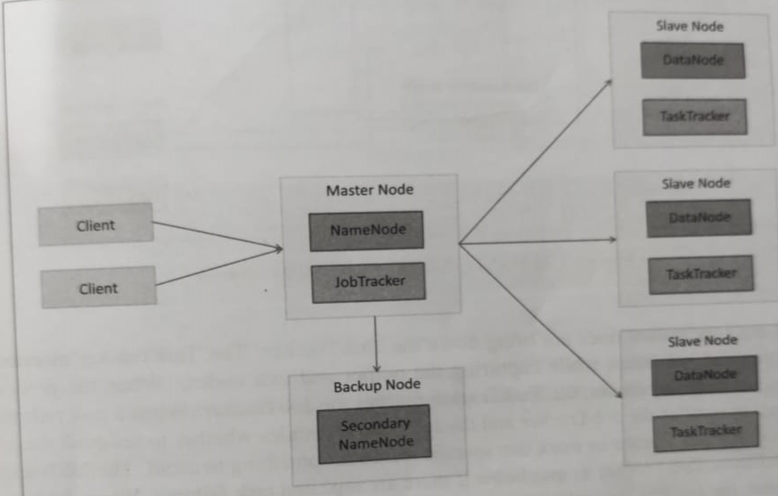
Hadoop Cluster

Slide 37
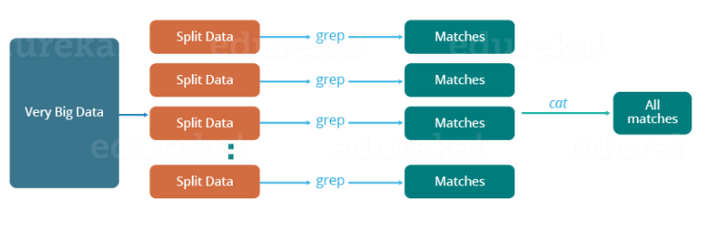
Traditional Way of Solving the Big problem
Task: Calculate the day having the highest temperature in each year from the log containing the daily average temperature of the years from 2000 to 2015..
Ref: https://www.edureka.co/blog/mapreduce-tutorial/

Slide 38
Challenges to deal with the traditional approach
Problems to dealt with:
Critical path problem (if, any of the machines delay the job, the whole work gets delayed.)
Reliability problem (What if, any of the machines which are working with a part of data fails?)
Equal split issue (how to equally divide the data such that no individual machine is overloaded or underutilized. )
The single split may fail: If any of the machines fail to provide the output, I will not be able to calculate the result. So, there should be a mechanism to ensure this fault tolerance capability of the system.
Aggregation of the result: There should be a mechanism to aggregate the result generated by each of the machines to produce the final output
To overcome the above challenges:
MapReduce framework allows us to perform such parallel computations without bothering about the issues like reliability, fault tolerance, load balancing, etc. Therefore, MapReduce gives us the flexibility to write code logic with
out caring about the design issues of the system

Slide 39
A Word Count Example of MapReduce
Task is to find out the count of each unique keyword of the given file.
File content:
Dear, Bear, River, Car, Car, River, Deer, Car, Bear

Slide 40
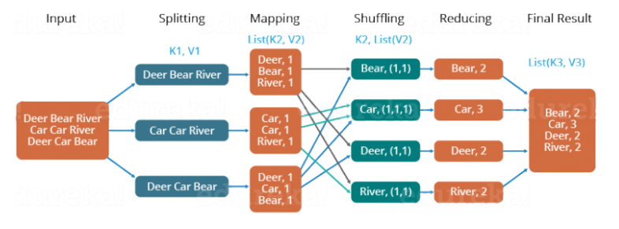
MapReduce Word Count Process

Slide 41
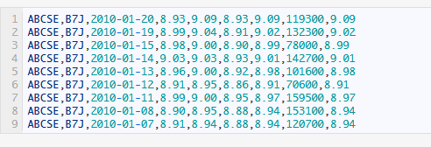
Another Example of MapReduce: Finding Maximum Closing Price of each stock symbol
Task: For every stock symbol in the dataset, we would like to find out its maximum closing price across several days.
Input Dataset:
Description of each line of input: For the symbol B7J. for date 2010-01-20 and we have the opening price, high, low close price, volume etc.
Ref:https://www.hadoopinrealworld.com/dissecting-mapreduce-components/

Slide 42
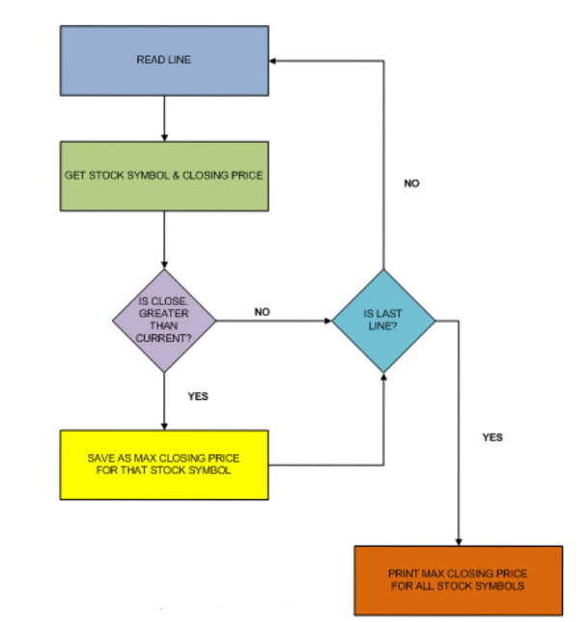
Sample Algorithm (Traditional way) to Solve the Problem
Problem:
If you have a huge dataset you will have extremely long
computation time which is not
ideal.

Slide 43
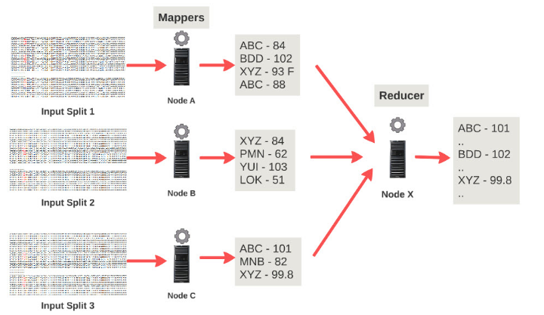
MapReduce Solving: Mapper Phase

Slide 44
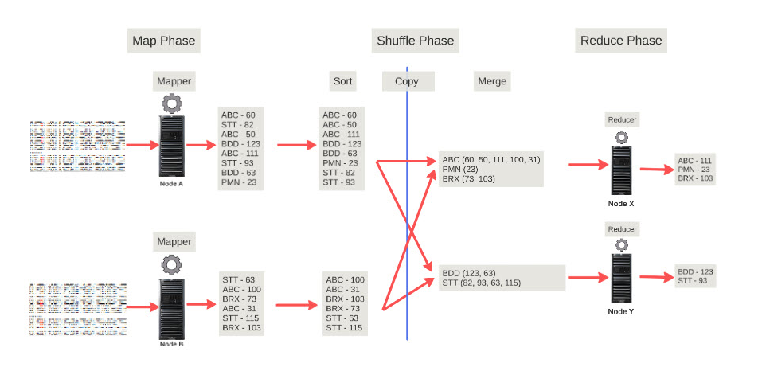
MapReduce Solving with Multiple Reducers

Slide 45
Another Example: Find the total sales of each book
The input is a log file that lists the sales of every book from different dealers (one book per line)

Slide 46
Map Phase and Reduce Phase
?
MapPhase: Output
Reducer Phase: Input
Reducer Phase: Output

Slide 47
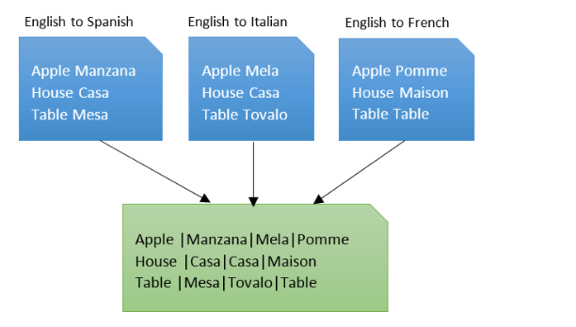
Another Example of MapReduce: Combining Dictionaries
Take a set of translation dictionaries, English-Spanish, English-Italian, English-French,and create a dictionary file that has the English word followed by all the different translations separated by the pipe (|) character.

Slide 48
References
Sanjay Ghemawat, Howard Gobioff, and Shun-Tak Leung, “Google File Systems”, SOSP '03: Proceedings of the nineteenth ACM symposium on Operating systems principles, Pages 29–432003, October 2003(https://dl.acm.org/doi/10.1145/1165389.945450)
Tom White, “Hadoop: The definitive Guide”, Third Edition, 2012.
Ananth K. Rao, “The DFS distributed file system: Design and implementation”,Thesis, RIT Scholar Works, 1989.

